Slide 1

Automotive control system Project
Presented By
Team 3: Yasmeen Abdelrazek Mohamed Mohamed Abdelmoniem Kirolos Nagy Omar Mohamed Marco Wafik
Supervisor:
Eng.Mostafa Ashraf
Eng. Abdallah Hiekal

Slide 2
Quick Overview
The project simulates some of the car control systems, it check the values coming from different sensors to detect the car state to start engine & include monitoring system to display the car state.
When the driver presses the button on the start key, it sends a signal to the system in the car to start the vehicle. It also has a temperature system (to check the engine temperature), an obstacles detector and Tires pressure monitoring system.

Slide 3
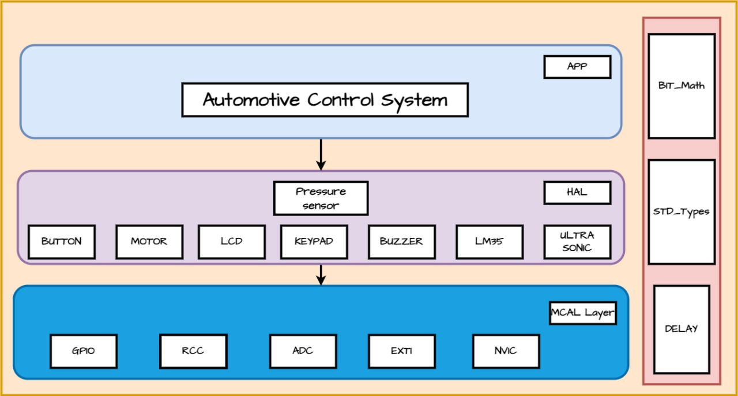
Static Architecture

Slide 4
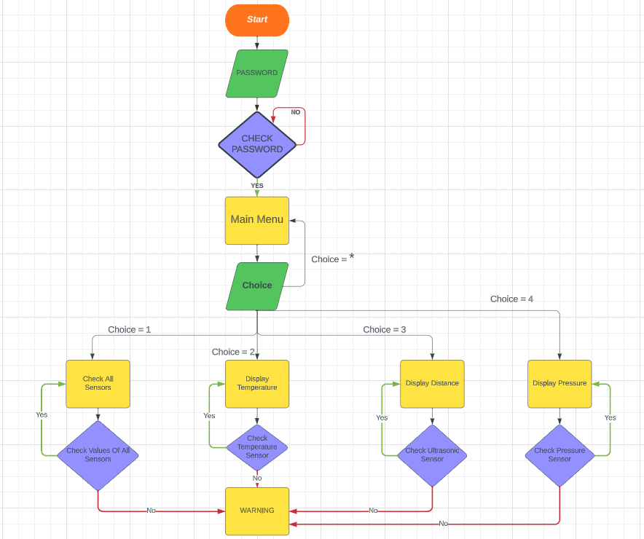
Project Flowchart

Slide 5
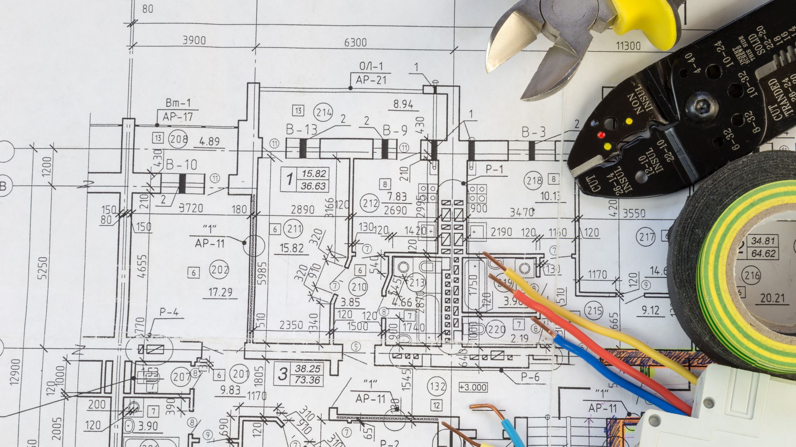
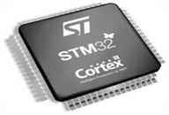
Project Hardware Design

Slide 6
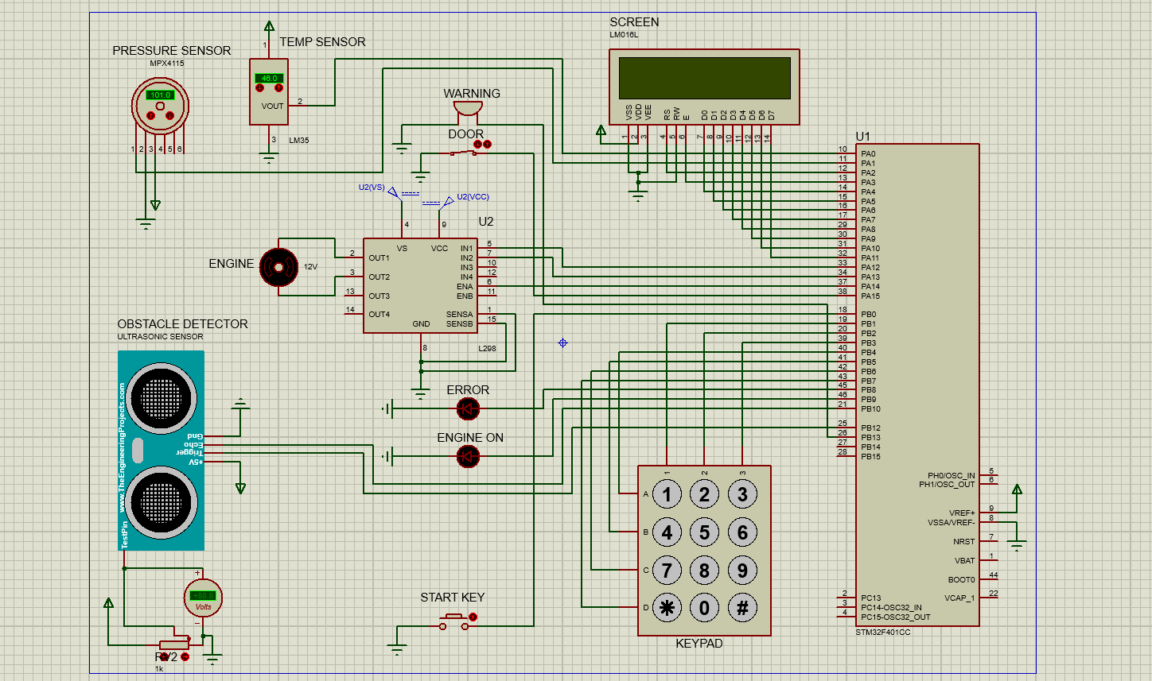

Slide 7
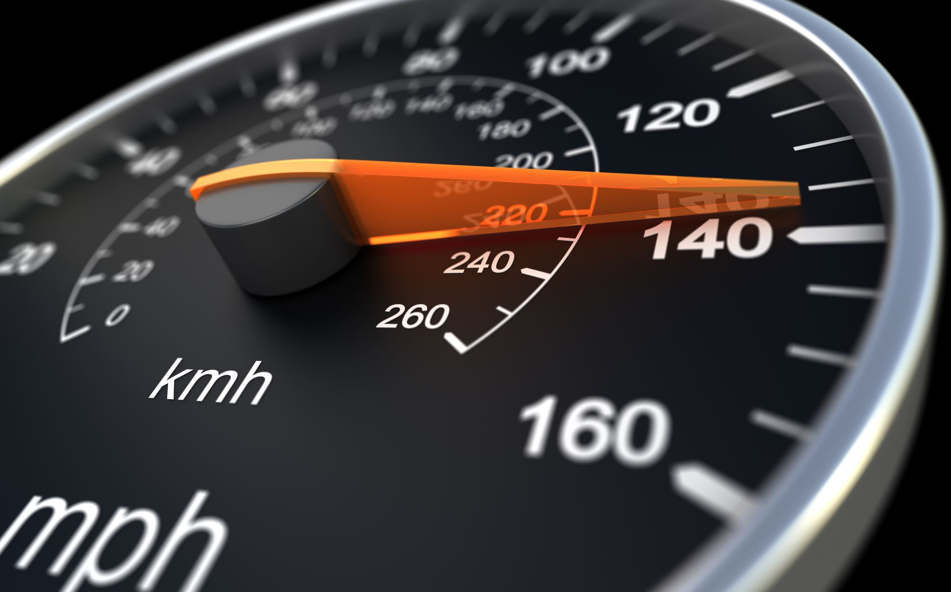
Project Features

Slide 8
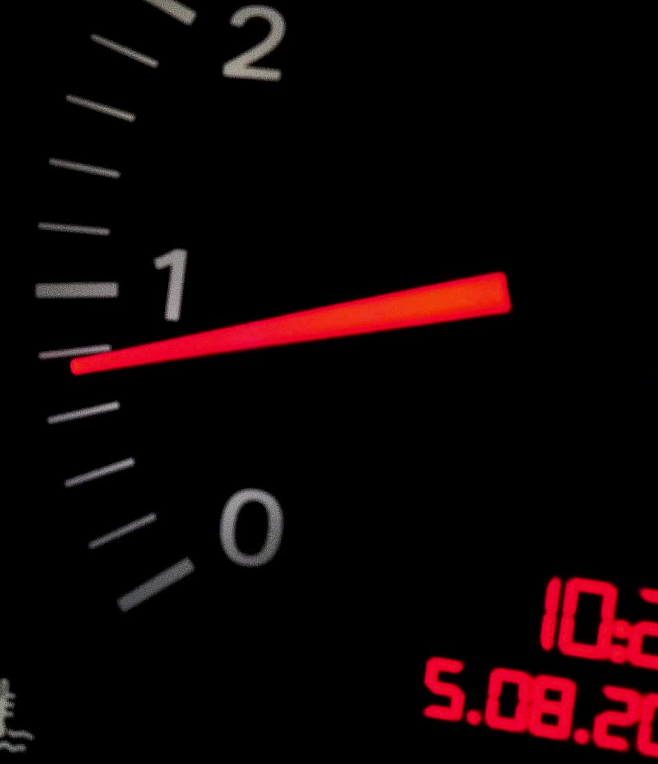
Password Check To Start System
The user enter the password using Keypad then the system automatically check it.
If the entered password is correct go to Main Menu

Slide 9

Start Key Button To Start Engine
Check button state continuously using external interrupt.
When the button pressed, the system will check the car door state.
If closed start engine, if not send WARNING.

Slide 10
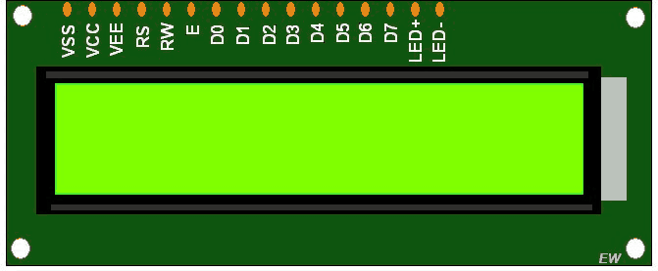
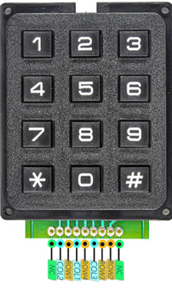
Components
Keypad
LCD
Push Button
Switch
LEDS
Buzzer
DC Motor

Slide 11

Main Menu
Display a menu on the LCD containing the available options for the user to choose from them.

Slide 12

Check All Sensors
Check the Values of all Sensors in the system then display the car state
If all values within the range, then display Ready To Start.
If only one error source, detect & display it.
If all sensors out of range display Not Ready.

Slide 13
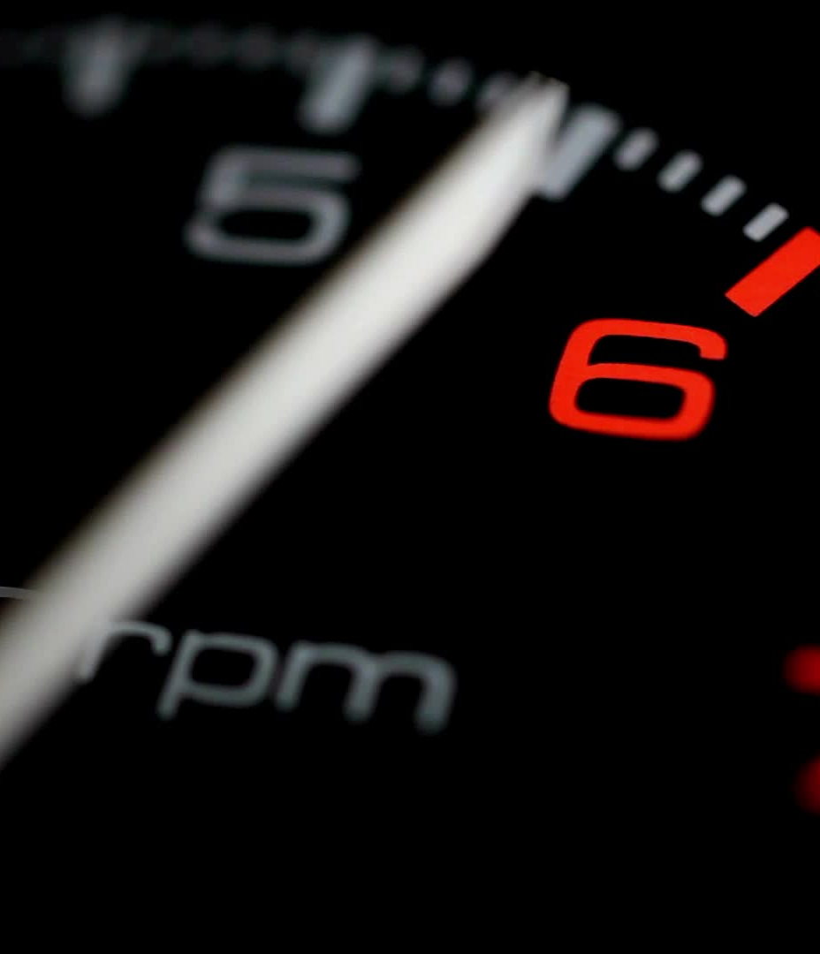
Engine Temperature Control by LM35
The Engine Temperature control function uses the information given from the temperature sensor.
It display the collected data on screen for the driver.
It gives WARNING if the values out of range.

Slide 14
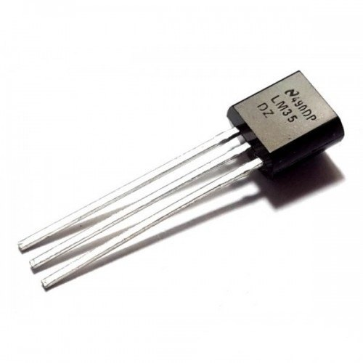
Components
Temperature sensor (LM35)
LCD
LEDs

Slide 15
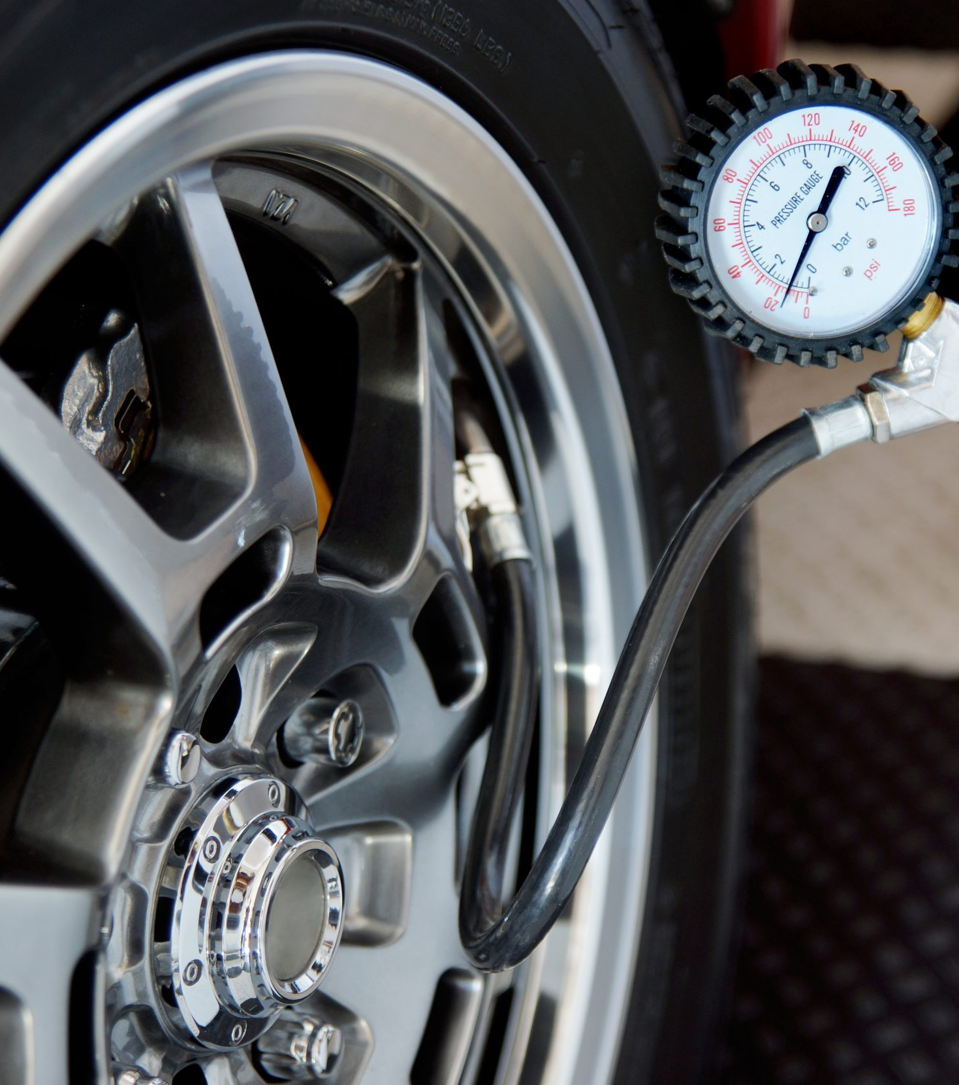
Tires Pressure Control by MPX4115
The Tires Pressure control function uses the information given from the Pressure sensor.
It display the collected data on screen for the driver.
It gives WARNING if the values out of range.

Slide 16
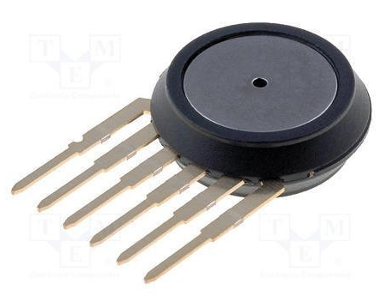
Components
Pressure sensor (MPX4115)
LCD
LEDs

Slide 17
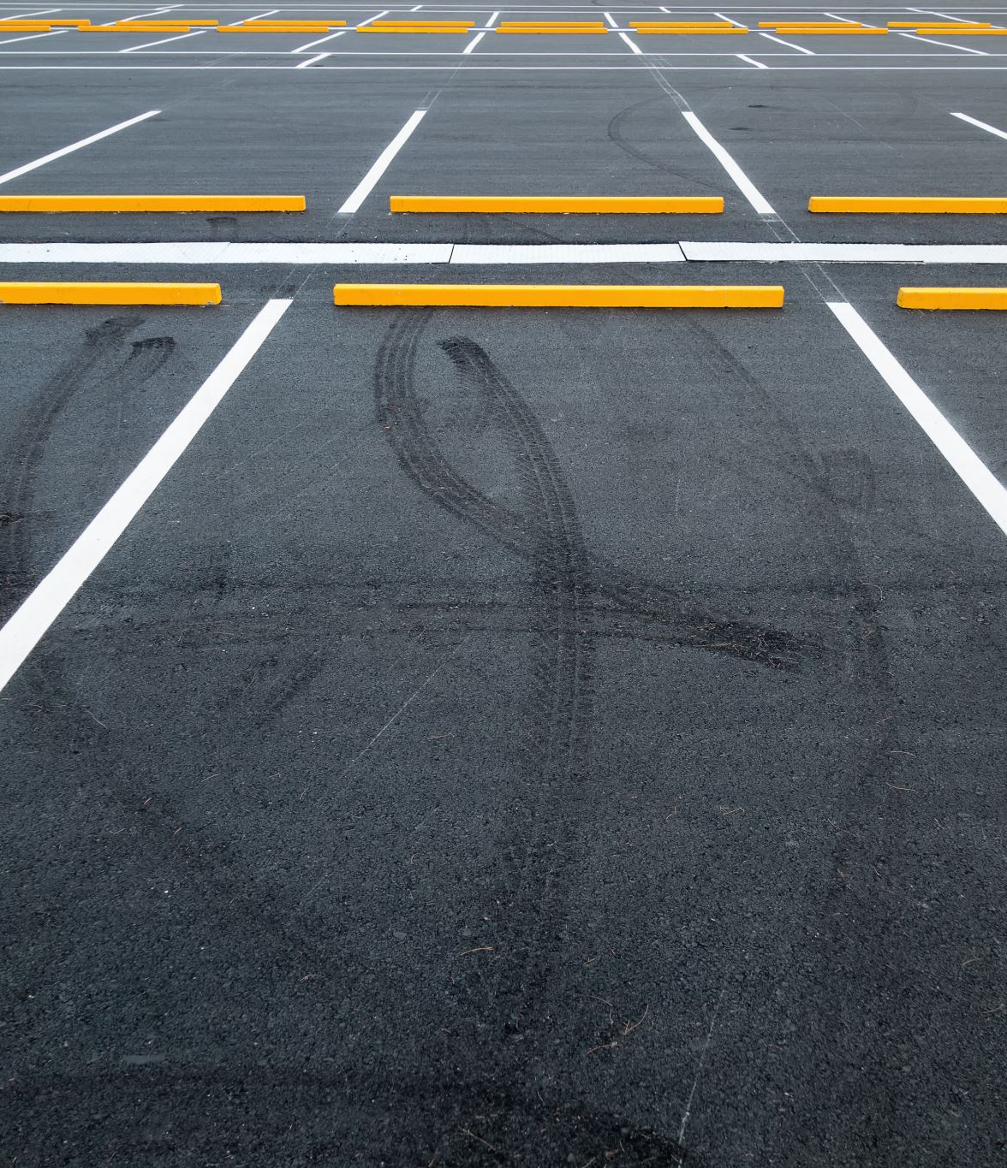
Distance Control by Ultrasonic
To avoid the car road obstacles by receiving data from the ultrasonic sensor.
It display the collected data on screen for the driver.
It gives WARNING if the values out of range.

Slide 18
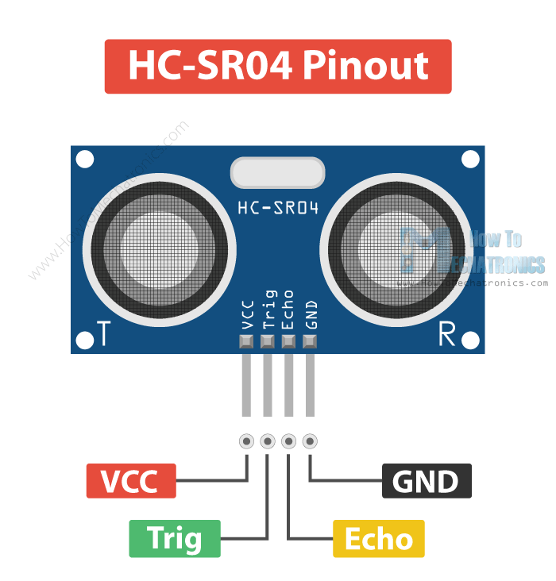
Components
Ultrasonic sensor
LCD
LEDs
Buzzer

Slide 19

Problems during Implementation
How ADC Works.
Implementation Of ADC driver.
Integration Problems.
Simulation errors.
How each component is connected.

Slide 20
Future Works
Light sensor : automatically adjusting the lighting levels based on environment conditions. This can ensure a great driving experience, especially during low-light situations, and contributes to overall road safety.
Real-time clock (RTC) : enables precise timekeeping, scheduling, and synchronization within our embedded system. The RTC ensures accurate data logging, event tracking, and synchronization across various components, enhancing overall system performance and reliability.
Tires Check : Replace the MPX4115 with DHT11, Because DHT11 by-measure both pressure and temperature so it’s better for check tires condition.

Slide 21


Thank you

